Slide 1
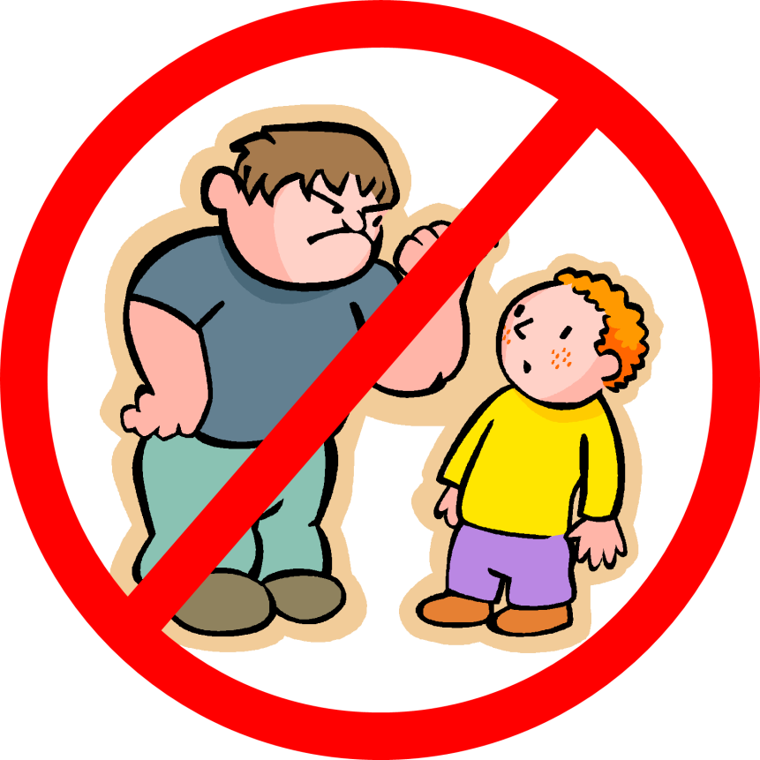
Bullying
What is it?
Who is involved?
What do you do?

Slide 2
What is bullying?
Bullying is when a “stronger” someone says or does mean things to another person on purpose to hurt them over and over again.
*“Stronger” means that person has more power than the other. This could be because they are scarier, bigger, older, more popular, etc.

Slide 3
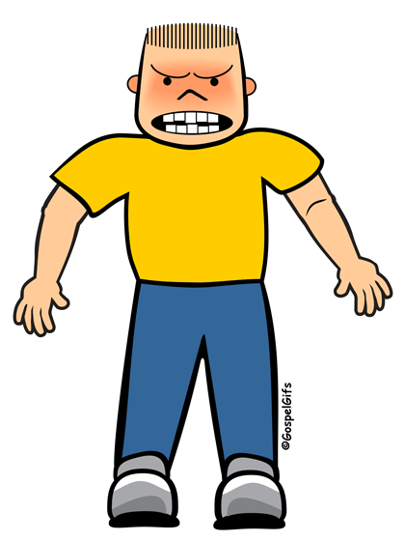
Who is involved?
Bully—The “stronger” person who says or does mean things to another person on purpose to hurt them over and over again. Bullies can be boys or girls.
*“Stronger” means that person has more power than the other. This could be because they are scarier, bigger, older, more popular, etc.
**Someone can be a bully in one situation but that doesn’t mean he/she is always a bully.

Slide 4
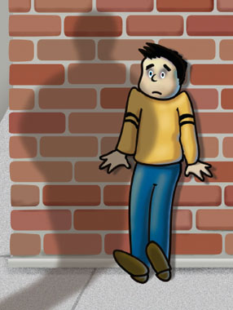
Who is involved?
Target—The person who has someone saying or doing mean things to them on purpose to hurt them over and over again.

Slide 5
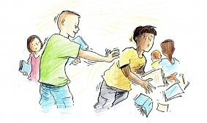
Who is involved?
Bystander—The person close by who see someone saying or doing mean things to others on purpose to hurt them over and over again.

Slide 6
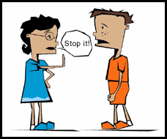
Who is involved?
Upstander—The person close by who see someone saying or doing mean things to others on purpose to hurt them over and over again BUT who also decides to help.

Slide 7
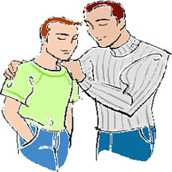
Who is involved?
Authority Figure—The adult person who can help stop the bullying situation, either during or after. This could be a parent, teacher, principal, or just another older person close by.

Slide 8
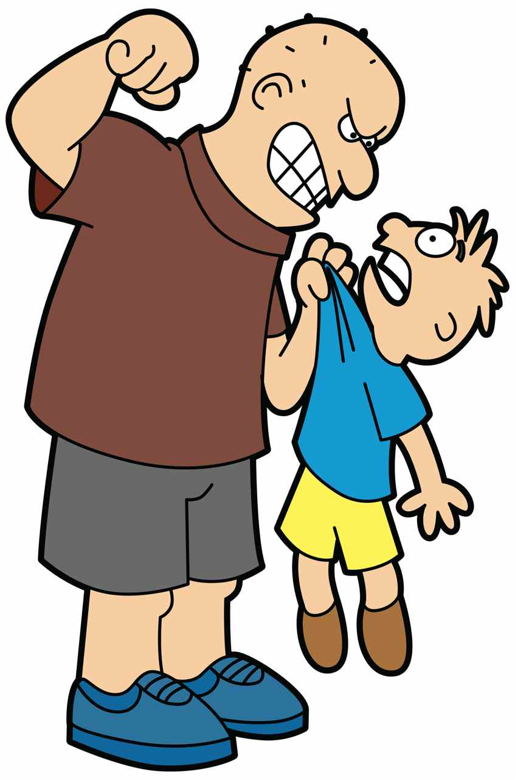
What happens?
Kinds of Bullying:
1. Physical bullying—Doing something to someone’s body/stuff
Hitting
Kicking
Tripping
Pinching
Pushing
Damaging property

Slide 9
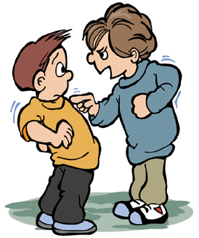
What happens?
Kinds of Bullying:
2. Spoken bullying—Saying something to or about someone while they are standing there
Name-calling
Insults
Teasing
Scaring
“Joking around” when both people are not enjoying the situation
Threatening
Encouraging others to hurt them

Slide 10
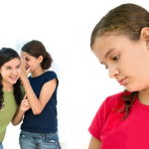
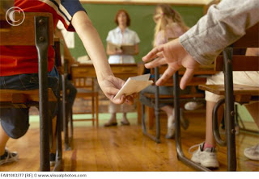
What happens?
Kinds of Bullying:
3. Social/Relational bullying—Doing something behind someone’s back, when they are not standing there, or that is not obvious to others nearby to hurt their reputation and/or cause embarrassment
Lying about them
Spreading rumors
Negative face or physical motions
Scary looks
Playing nasty jokes to embarrass them
Copy-catting them
Encouraging others to not talk to or sit by them.

Slide 11
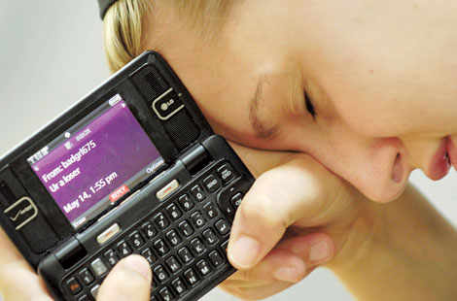
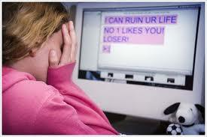
What happens?
Kinds of Bullying:
4. Written—Hurting someone through writing notes or online by saying things or using embarrassing pictures to hurt them or their reputation through websites, social networks (like Facebook, Twitter, Instagram, etc.), or by cell phone
Texting or posting mean messages
Texting or posting embarrassing pictures
Getting others to gang up on or threaten them
Setting up a website to make fun of them
Making mean or threatening posts on their page
Passing notes about them in class

Slide 12
How do I know if it really is bullying?
This issue has happened over and over.
The same person/people are involved.
What happened was done on purpose.
It hurt (body or feelings).
There is a difference in power between the person being mean and their target.
*All 5 must be checked for it to be considered bullying and not someone just being mean.

Slide 13
Bullying vs. Being Mean
It is bullying if:
It has happened over and over.
It has happened with the same people.
It was done on purpose.
It hurt someone (body or feelings).
There is a difference in “strength” between the two people.
It is being mean if:
It has only happened this time or it has been a long time since it happened before.
It is different people doing it each time.
It was an accident.
The people involved are not upset.
The people involved are at the same level socially.

Slide 14
What do I do?
What do I do if someone is bullying me?
Try not to let the bully see you are upset.
Stand up for yourself nicely.
Walk away.
Tell someone you trust about it.
If the person you told cannot help you or does not do anything, find someone else! Never keep being bullied a secret!
Avoid areas where the bully feels comfortable picking on you—corners of the playground, lonely corridors, and behind large furniture in the classroom.
Know your bully. Sometimes different things can make the
situation worse.
Try to surround yourself with friends and people who will stand
up for you.

Slide 15
What do I do?
What do I do if I see someone
being bullied?
Find someone to help stop it.
Stand next to the kid being picked on.
Say something nicely.
Pull the kid being bullied away from the situation and stay with them.
Don't cheer the bully on or stand around to watch.
Be nice to, include, and get to know people who are being bullied: You may make a new friend!
Try to make friends with the bully at some other time to show them other ways to treat others.

Slide 16
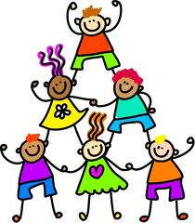
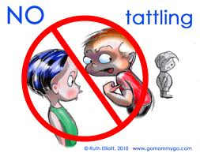
Reporting vs. Tattling
It is reporting if:
It is getting someone out of trouble.
It is important.
It is harmful and/or dangerous.
It is being mean on purpose.
It is tattling if:
It is getting someone into trouble.
It is not important.
It is harmless.
It is an accident.

