Slide 1
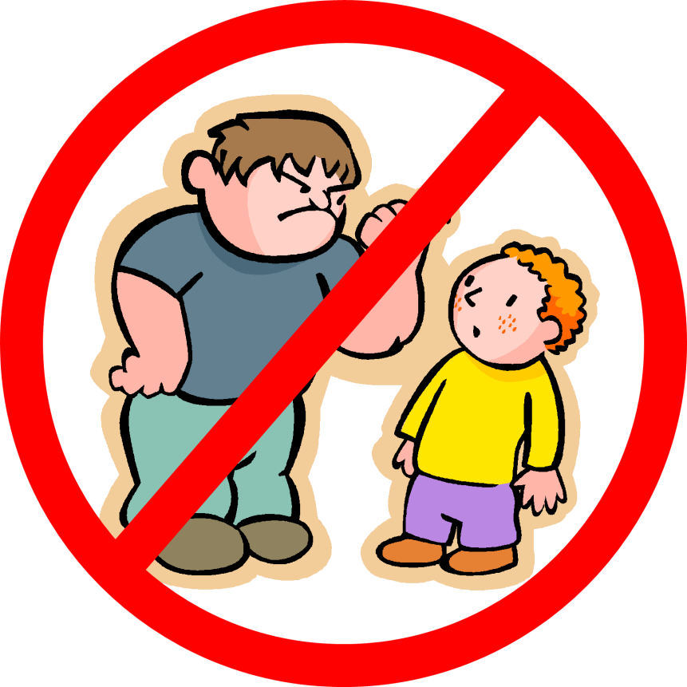
Bullying

Slide 2
What is bullying?
Bullying is when a “stronger” person says or does mean things to another person on purpose to hurt them over and over again.
*“Stronger” means that person has more power than the other. This could be because they are scarier, bigger, older, more popular, etc.

Slide 3
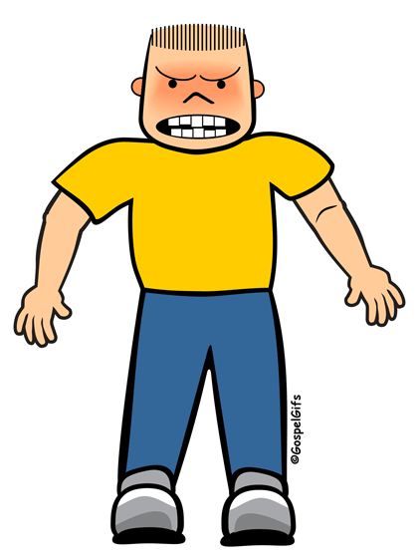
Who is involved?
Bully—The “stronger” person who says or does mean things to another person on purpose to hurt them over and over again. Bullies can be boys or girls.
*“Stronger” means that person has more power than the other. This could be because they are scarier, bigger, older, more popular, etc.

Slide 4
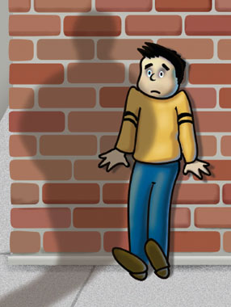
Who is involved?
Target—The person who has someone saying or doing mean things to them on purpose to hurt them over and over again.

Slide 5
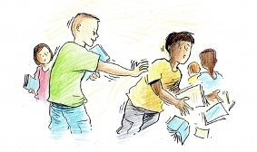
Who is involved?
Bystander—The person close by who see someone saying or doing mean things to someone on purpose to hurt them over and over again but they don’t do anything to help them.

Slide 6
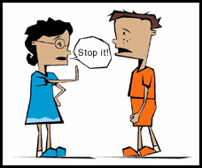
Who is involved?
Upstander—The person close by who see someone saying or doing mean things to someone on purpose to hurt them over and over again BUT who also decides to help. They stand UP for someone. A bystander can turn into an upstander when they decide to DO something to help.

Slide 7
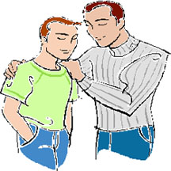
Who is involved?
Authority Figure—The adult person who can help stop the bullying situation, either during or after. This could be a parent, teacher, principal, or just another older person close by.

Slide 8
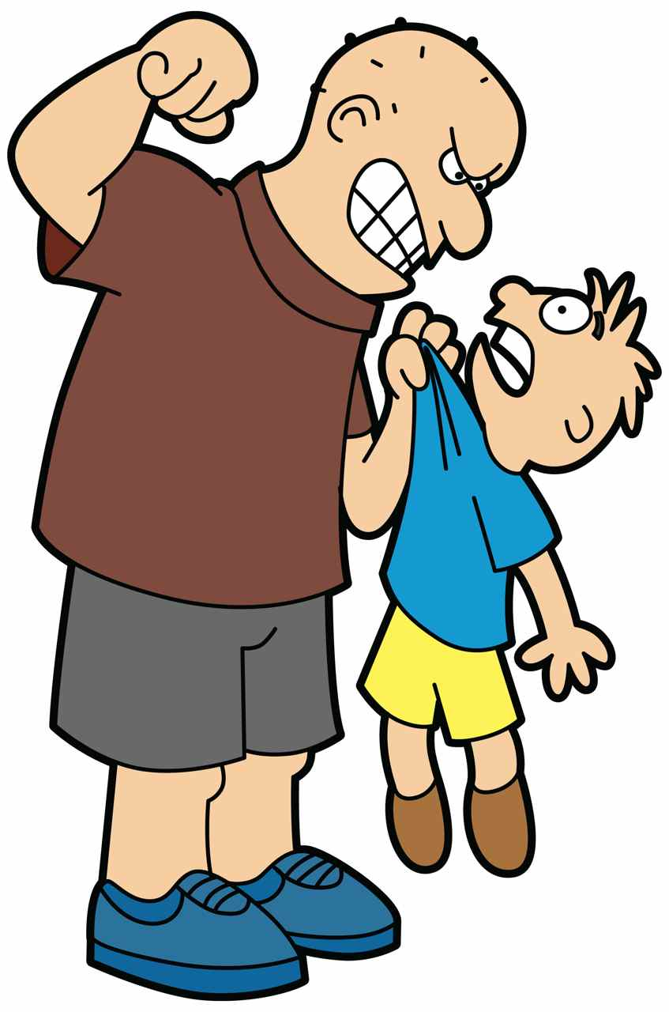
Who is this?
A.
B.
Notes:
A=Bully
B=Target

Slide 9
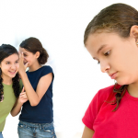
Who is this?
A.
B.
Notes:
A=Bully
B=Target

Slide 10
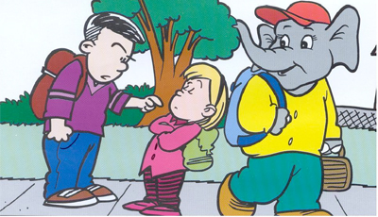
Who is this?
A.
B.
C.
Notes:
A=Bully
B=Bystander (unless he is leaving to go get help and then he becomes an Upstander)
C=Target

Slide 11
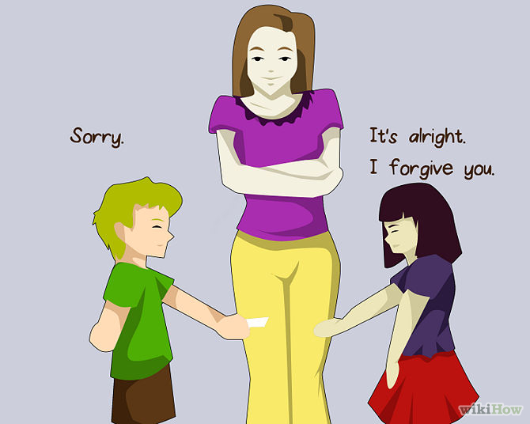
Who is this?
A.
B.
C.
Notes:
A=Authority Figure
B=Bully
C=Target

Slide 12
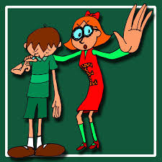
Who is this?
A.
B.
Notes:
A=Target
B=Upstander

Slide 13
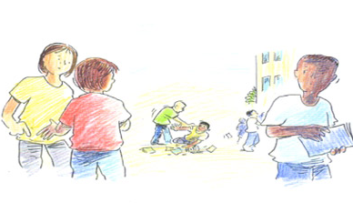
Who is this?
C.
D.
A.
B.
Notes:
A=Bystander
B=Bystander
C=Bully
D=Target

Slide 14
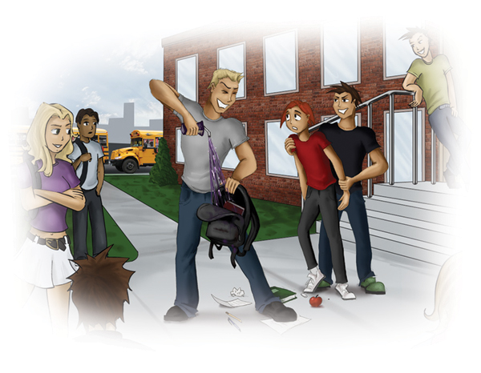
Who is this?
B.
C.
A.
E.
D.
Notes:
A=Bystander/Bully
B=Bystander/Bully
C=Bully
D=Bully
E=Target

Slide 15
Who is this?
A.
B.
C.
Notes:
A=Bullies
B=Upstander
C=Target

Slide 16
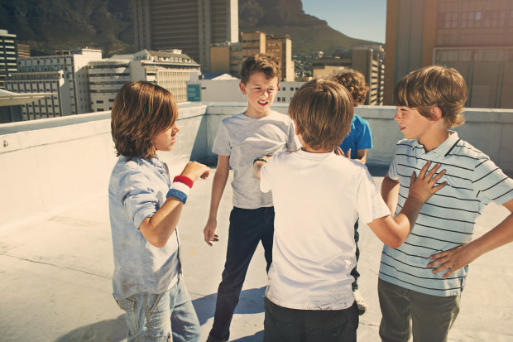
Who is this?
A.
B.
C.
Notes:
A=Bully
B=Target
C=Upstander

Slide 17
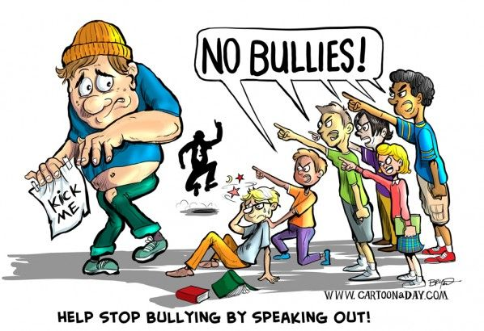
Who is this?
B.
A.
C.
D.
Notes:
A=Bully
B=Authority Figure
C=Upstanders
D=Target

Slide 18
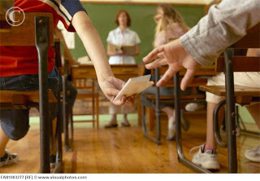
Who is this?
A.
B.
Notes:
A=Bully
B=Bystander/Bully

Slide 19
How do I know if it really is bullying?
This issue has happened over and over.
The same person/people are involved.
What happened was done on purpose.
It hurt (body or feelings).
One person is more “powerful” than the other. (Powerful means stronger, older, more popular, has more authority, etc.)
*All 5 must be checked for it to be considered bullying and not someone just being mean.

Slide 20
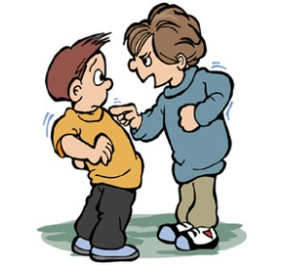
Bullying vs. Being Mean
It is bullying if:
It has happened over and over.
It has happened with the same people.
It was done on purpose.
It hurt someone (body or feelings).
There is a difference in “strength” between the two people.
It is being mean if:
It has only happened this time or it has been a long time since it happened before.
It is different people doing it each time.
It was an accident.
The people involved are not upset.
The people involved are at the same level socially.

Slide 21
What do I do?
What do I do if someone is bullying me?
Try not to let the bully see you are upset.
Stand up for yourself nicely.
Walk away.
Tell someone you trust about it.
If the person you told cannot help you or does not do anything, find someone else! Never keep being bullied a secret!
Avoid areas where the bully feels comfortable picking on you—corners of the playground, lonely corridors, and behind large furniture in the classroom.
Know your bully. Sometimes different things can make the
situation worse.
Try to surround yourself with friends and people who will stand
up for you.

Slide 22
What do I do?
What do I do if I see someone
being bullied?
Find someone to help stop it.
Stand next to the kid being picked on.
Say something nicely.
Pull the kid being bullied away from the situation and stay with them.
Don't cheer the bully on or stand around to watch.
Be nice to, include, and get to know people who are being bullied: You may make a new friend!
Try to make friends with the bully at some other time to show them other ways to treat others.

Slide 23
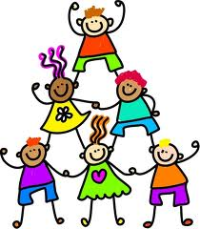
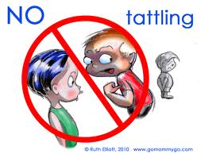
Reporting vs. Tattling
It is reporting if:
It is getting someone out of trouble.
It is important.
It is harmful and/or dangerous.
It is being mean on purpose.
It is tattling if:
It is getting someone into trouble.
It is not important.
It is harmless.
It is an accident.

